Slide 1

MIT-WPU Campus Network using Subnetting
Shreerang Mhatre – 52
Sarvesh Gurav – 44

Slide 2
Introduction
In today's digital age, a robust and efficient campus network is essential for facilitating seamless communication, collaboration, and resource sharing among students, faculty, and staff. This project aims to demonstrate the principles of subnetting and network design by creating MIT campus network using Cisco Packet Tracer. We will design and implement a network topology, configure devices with appropriate IP addresses and subnet masks, simulate network traffic, and analyze network performance to identify potential bottlenecks.
The primary objective is to establish secure connections between four personal computers (PCs) and two printers, utilizing subnetting for optimal IP address management, network efficiency, and security.

Slide 3
Network Stacks :
01
Subnetting:
Subnetting is the process of creating a subnetwork (also known as a subnet) within a network. Network interfaces and devices within a subnet can communicate with each other directly. Routers facilitate communication between different subnets.
02
Subnet Mask:
A subnet mask is a 32-bit address that segregates an IP address into network bits that identify the network and host bits that identify the host device operating on that network. It encapsulates a range of IP addresses that a subnet can use, wherein the subnet refers to a smaller network within a more extensive network.

Slide 4
Network Stacks :
03
IP Address:
An IP address is a unique address that identifies a device on the internet or a local network. IP stands for "Internet Protocol," which is the set of rules governing the format of data sent via the internet or local network.
04
Range of Valid Host:
The valid hosts are the numbers in between the subnet and broadcast addresses

Slide 5
Network Stacks :
05
Broadcast ID:
A broadcast address is a special Internet Protocol (IP) address used to transmit messages and data packets to network systems.
The broadcast address for a subnet must account for the part of the address that is reserved for the subnet
06
Default Gateway:
The default gateway is the node that forwards the packet from the source to other networks when there is no routing information about the destination i.e. host (or router) does not know where the destination is present.

Slide 6
Network Stacks :
07
Router :
A router is a device that connects two or more packet-switched networks or subnetworks. It serves two primary functions: managing traffic between these networks by forwarding data packets to their intended IP addresses, and allowing multiple devices to use the same Internet connection
08
Switches :
A network switch connects network devices (printers, computers, and wireless devices/access points, and enables users to exchange data packets

Slide 7
Nodes Used:
Router | x1 | To establish connection between two Schools and act as main Connection
Switches | x2 | To exchange data packets and communication
PCs | x4 | To display the communication/ connection
Printer | x2 | Additional device

Slide 8
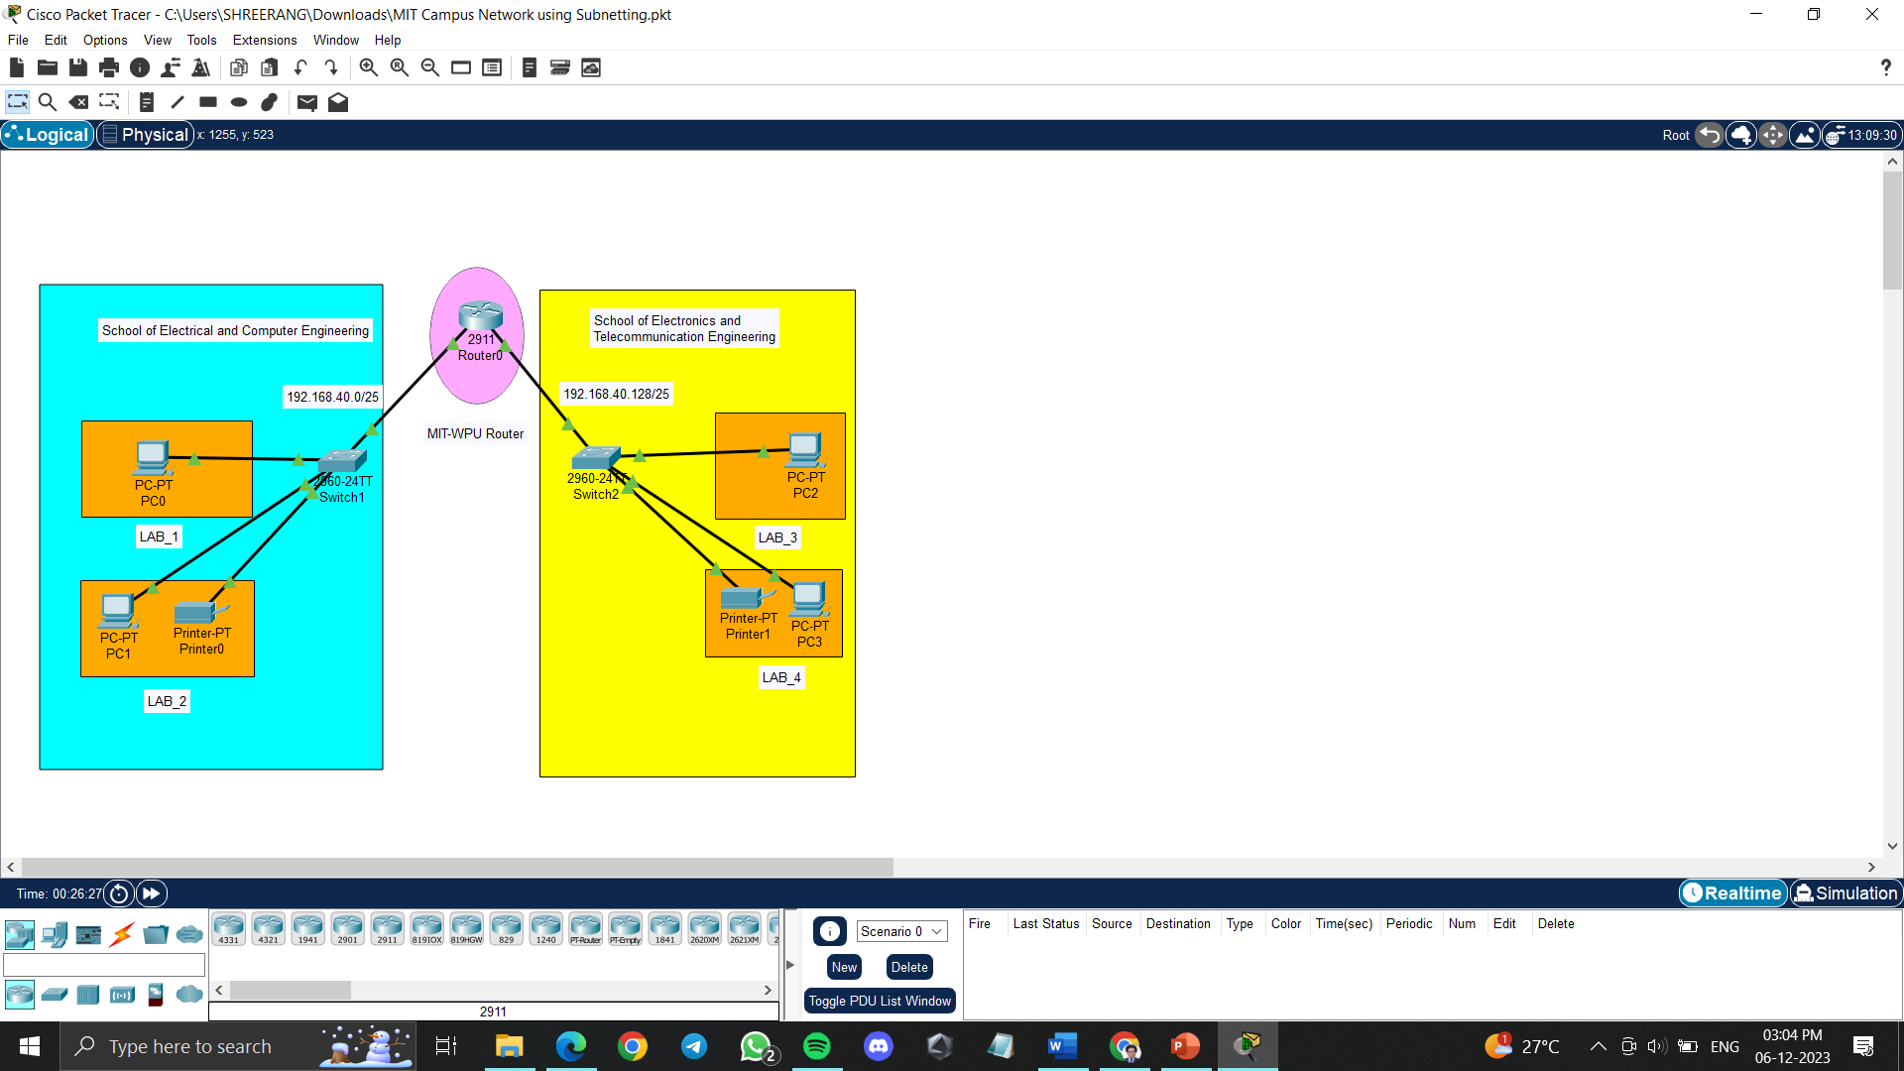
MIT Campus Network

Slide 9
Explanation:
Demonstrating Subnetting through Pinging
Subnetting is a crucial technique for dividing a large network into smaller, more manageable subnets. It enhances network efficiency, security, and traffic flow. To effectively demonstrate subnetting's functionality, we will ping the IP address of a PC in one department to a PC in another department within the MIT-WPU Campus Network.
Pinging Procedure:
- Identify PCs: Select one PC from each department, ensuring they are assigned IP addresses within their respective subnets.
- Initiate Ping: Using the ping command, initiate a ping request from the PC in School of Electrical to the PC in School of Electronics.
- Observe Ping Output: After pinging in we observe the connection between the two PCs of two Schools. A successful ping indicates that the two PCs can communicate effectively, demonstrating successful subnetting implementation.

Slide 10
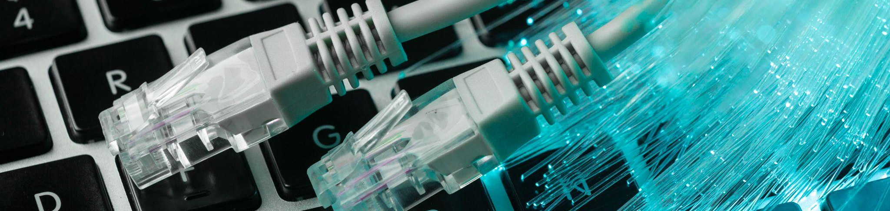
Execution

Slide 11
Configuration setup
Base Network = 192.168.40.0
No. of Subnets = no. of departments
2^n = no. of Subnets ======== 2^n=2 --- N= 1
255.255.255.255
If 1 bit is borrowed 11111111. 11111111. 11111111. 10000000
Hence the subnet mask becomes: 255.255.255.128
Block size is 128
1st Subnet
Subnet mask = 255.255.255.128
Network ID = 192.168.40.0
Range of Valid Host = 192.168.40.1 – 192.168.40.126 // host devices will occupy this range
Broadcast ID = 192.168.40.127 // 0-127 will satisfy the block size (128)
2nd Subnet
Subnet mask = 255.255.255.128
Network ID = 192.168.40.128
Range of Valid Host = 192.168.40.129 – 192.168.40.254 // host devices will occupy this range
Broadcast ID = 192.168.40.255 // 128 - 255 will satisfy the block size (128)

Slide 12
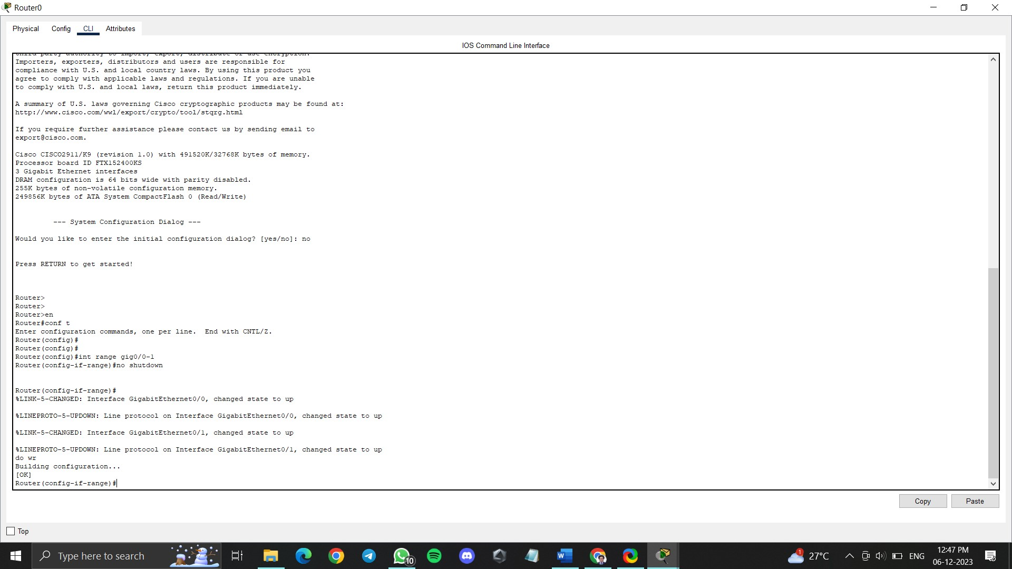
Initialization and Configuration of Router

Slide 13
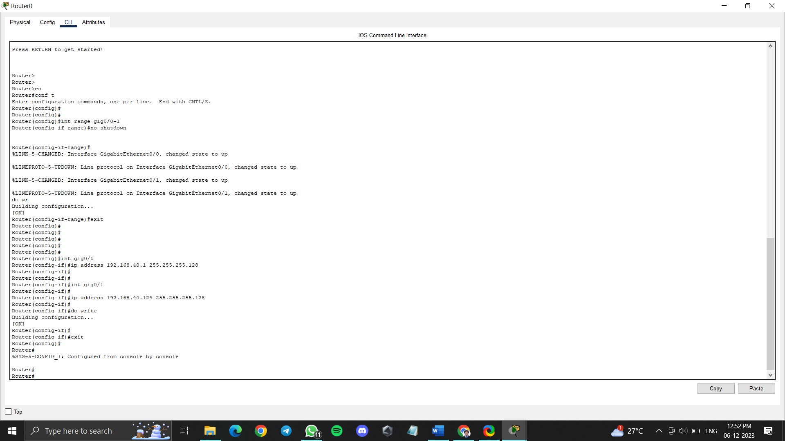
Router Interfacing and
Assigning IP address to switch and router connection

Slide 14
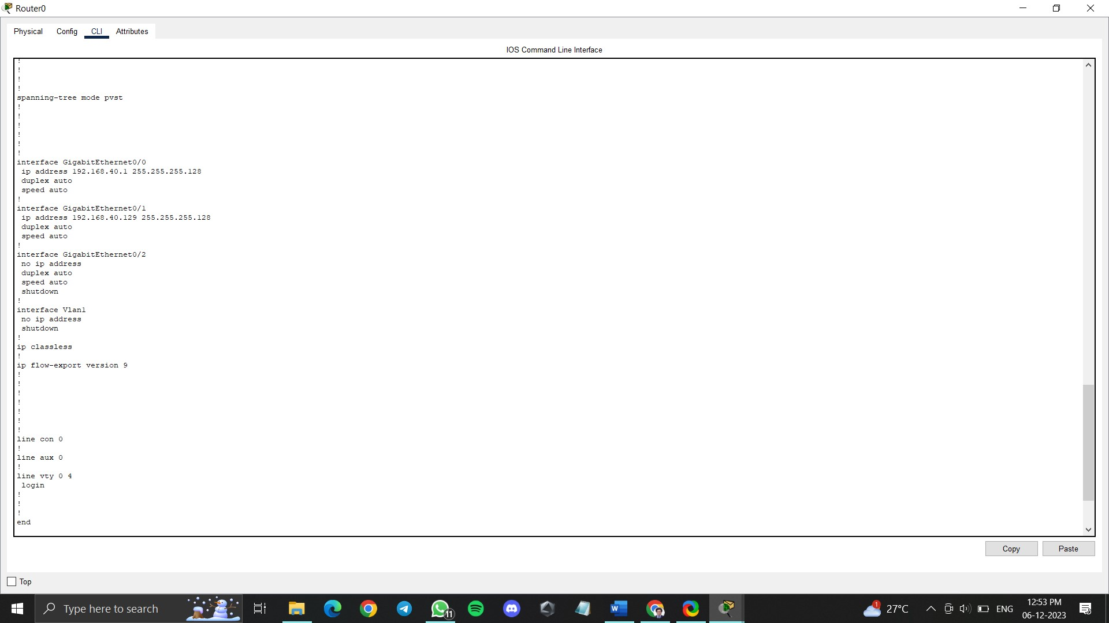
Output of Interfacing communication

Slide 15
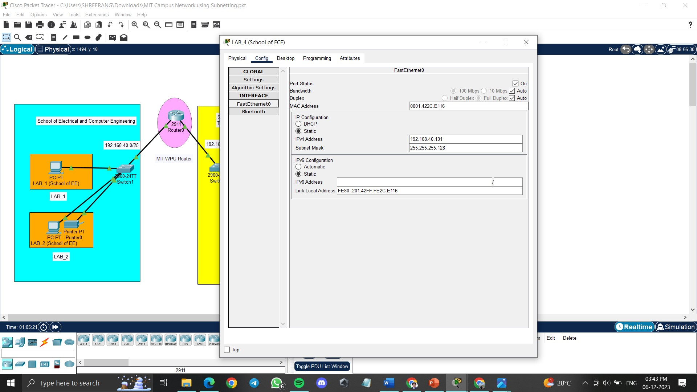
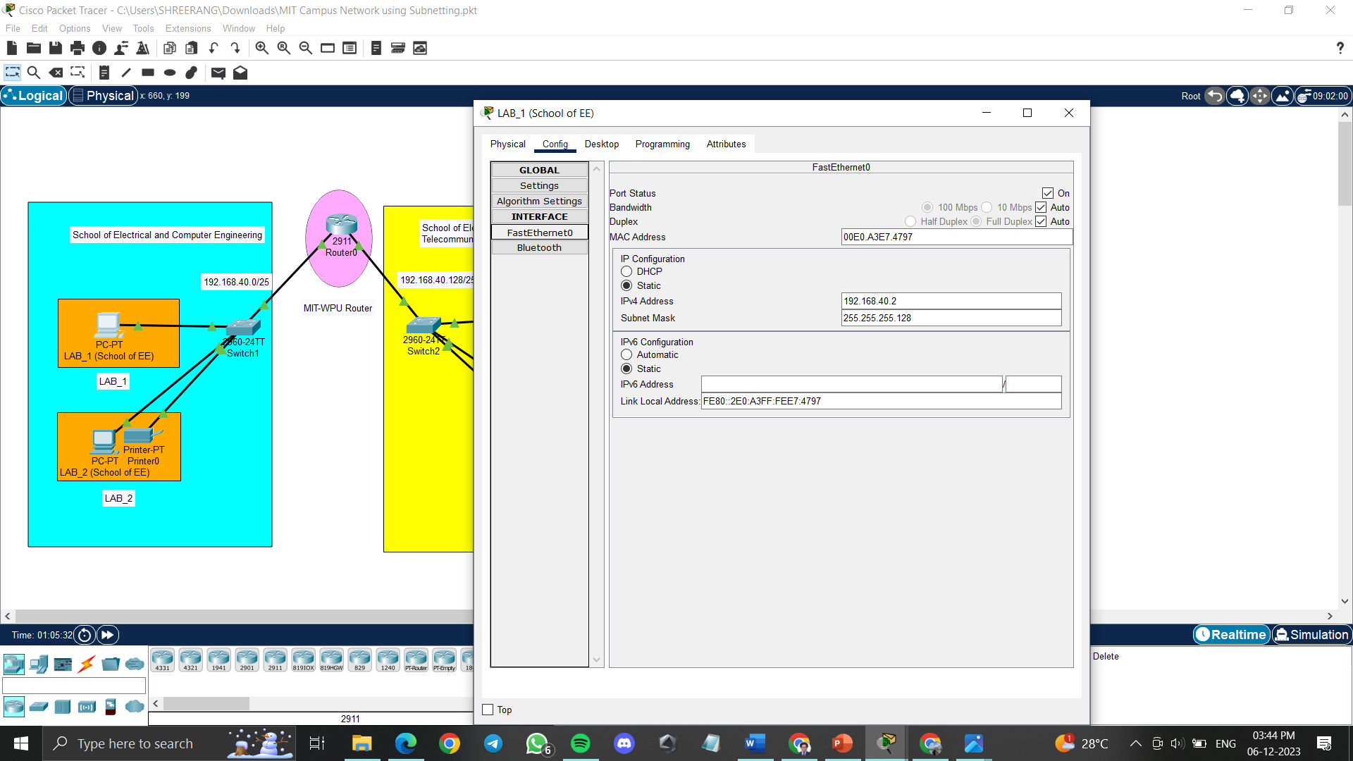
Configuring Communication between Lab4 of ECE and Lab4 of EE

Slide 16
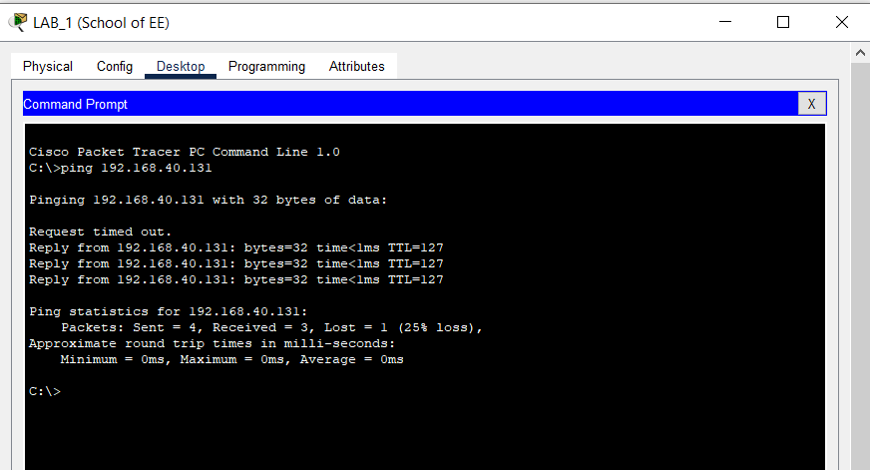
Configuring Communication between Lab4 of ECE and Lab4 of EE
The IP address of Lab4 Pc from ECE was pinged by the Lab1 Pc of EE

Slide 17
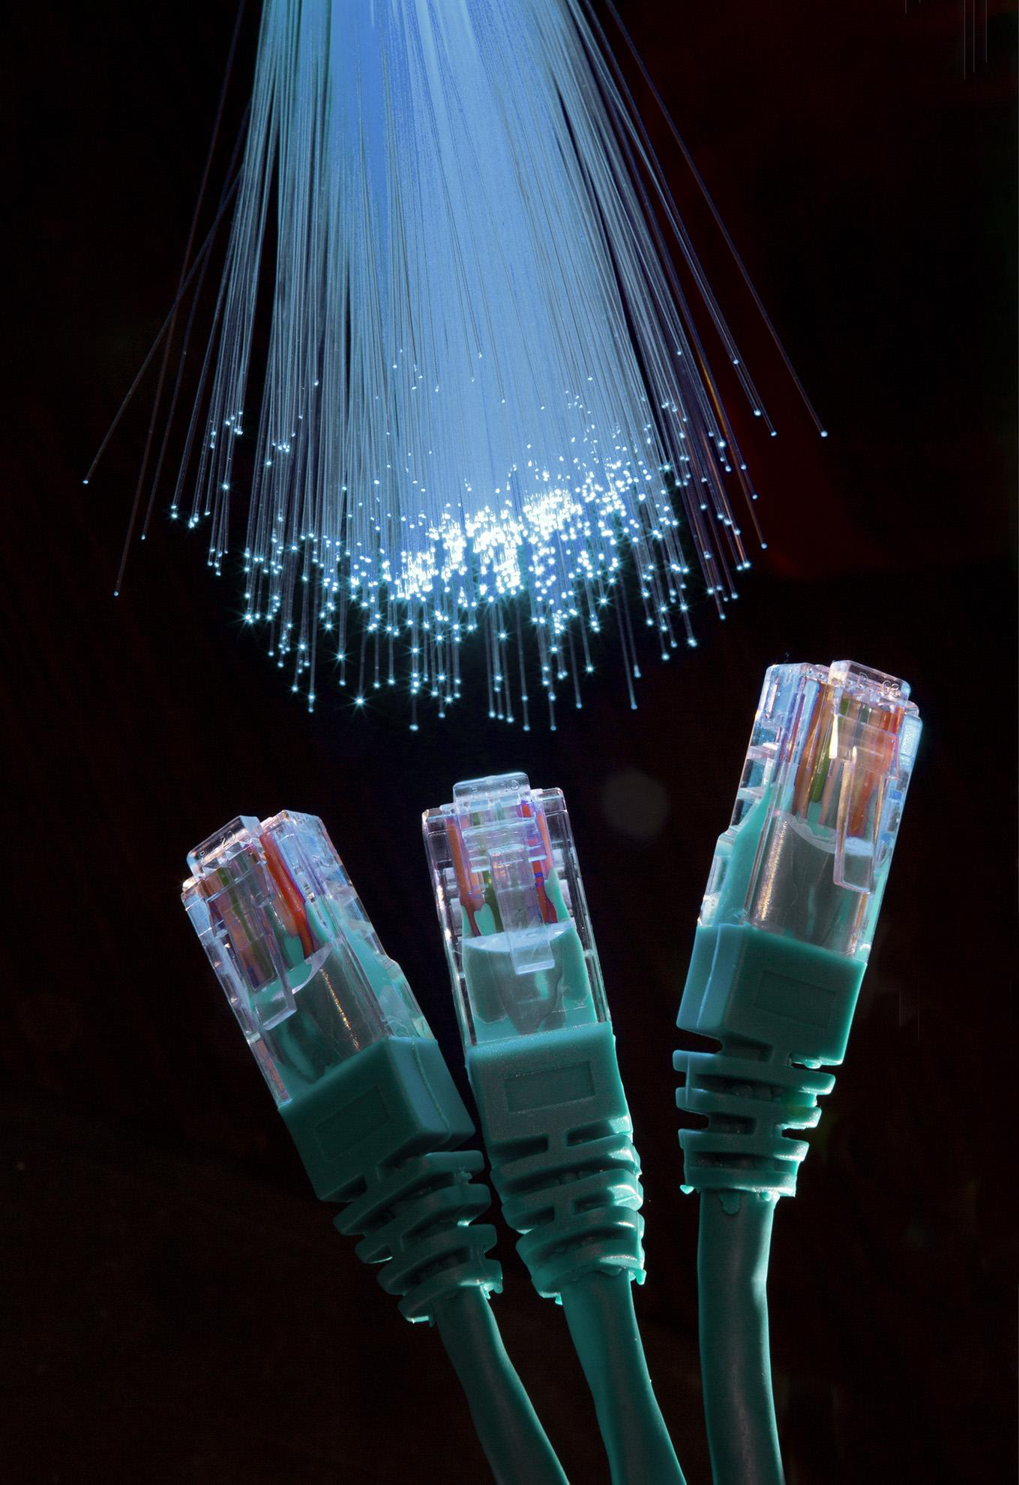
Conclusion
The subnetting network of MIT-WPU Campus was successfully demonstrated with the help of Cisco Packet Tracer. The communication between the School of Electronics and School of Electrical was observed, providing an overall idea of how subnetting works, how to configure and initialize the network, and how to host a network on simulation. This project highlights the importance of subnetting in network design and management, and how it can be used to optimize network performance. By dividing a large network into smaller subnets, it is possible to reduce network congestion, improve security, and simplify network management. Cisco Packet Tracer is an excellent tool for simulating network configurations and testing different scenarios, making it an essential tool for network engineers and administrators.

Slide 18
Resources
https://www.netacad.com/courses/packet-tracer
https://www.solarwinds.com/resources/it-glossary/subnetting
https://www.geeksforgeeks.org/introduction-to-subnetting/
https://www.geeksforgeeks.org/basics-computer-networking/?ref=lbp
https://www.kaspersky.com/resource-center/definitions/what-is-an-ip-address
https://www.techtarget.com/searchnetworking/definition/switch

Slide 19
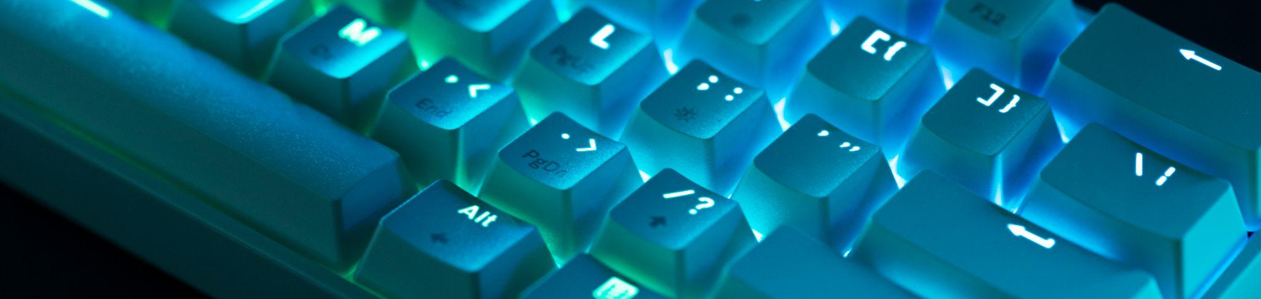
Thankyou

